Slide 1
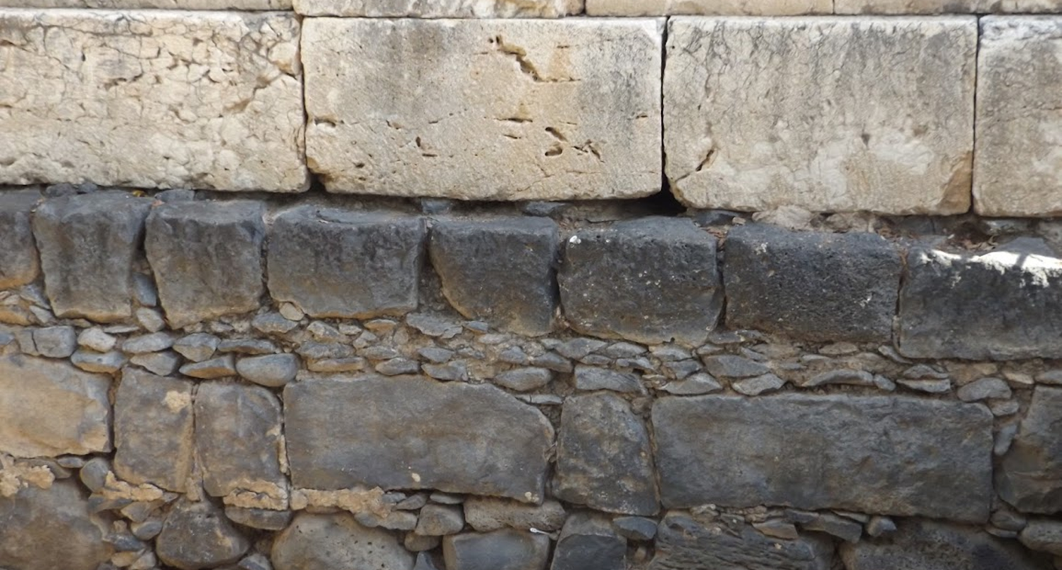

Studies in the Epistles
Foundations  Quarter 17
Lesson 3: First Timothy 4-6

Slide 2
Outline of 1 Timothy
Chapter One – Timothy is to wage the good warfare.
Chapter Two – Expectations for the public behavior of believers.
Chapter Three – Qualifications of elders and deacons
Chapter Four – Guarding against departing from the faith: Saving others and himself from false teaching.
Chapter Five – Dealing with the Family of God: Differences in age, gender, economic status and spirituality.
Chapter Six – Focus on the gain of godliness, not material riches.

Slide 3
Guarding Against Departing from the Faith (1 Timothy 4)
The Spirit warns that some will depart from the faith (4:1-5).
The Spirit speaks “expressly” (cf. 1 Cor. 2:13).
He warns that some will depart from the faith.
Giving heed to deceiving spirits and doctrines of demons.
Speaking lies in hypocrisy.
Having their conscience seared. NOTE: Paul had earlier connected having a good conscience and remaining faithful (1 Tim. 1:5, 19; 3:9).
Specific errors would include…
Forbidding to marry.
Requiring abstinence from certain foods which God created to be received with thanksgiving (cf. Acts 10:9-16).
Being thankful for our food is important (cf. John 6:11, 23).
Notes:
1 Corinthians 2:13 These things we also speak, not in words which man's wisdom teaches but which the Holy Spirit teaches, comparing spiritual things with spiritual.
John 6:11 And Jesus took the loaves, and when He had given thanks He distributed them to the disciples, and the disciples to those sitting down; and likewise of the fish, as much as they wanted.

Slide 4
Guarding Against Departing from the Faith (1 Timothy 4)
Characteristics of a “good minister” (4:6-16).
A good minister will teach and exemplify good doctrine (4:6).
He will refuse earthly myths or fables as the basis of doctrine (4:7a).
He will exercise himself to godliness (4:7b-11).
Godliness promises life now and life to come.
This truth should be accepted by all; a minister strives to convey it!
Others will not have reason to look down on his youth because he lives an exemplary life of godliness (4:12).
He focuses himself on reading Scripture and teaching (4:13).
He uses his gifts and talents to their fullest (4:14).
He gives himself entirely to his work and all see his progress (4:15).
By taking heed to these things, he saves himself and others (4:16).
Notes:
“Godliness” is found 9 times in 1 Timothy but only 7 other times in the whole New Testament
1Ti_2:2 for kings and all who are in authority, that we may lead a quiet and peaceable life in all godliness and reverence.
1Ti_2:10 but, which is proper for women professing godliness, with good works.
1Ti_3:16 And without controversy great is the mystery of godliness: God was manifested in the flesh, Justified in the Spirit, Seen by angels, Preached among the Gentiles, Believed on in the world, Received up in glory.
1Ti_4:7 But reject profane and old wives' fables, and exercise yourself toward godliness.
1Ti_4:8 For bodily exercise profits a little, but godliness is profitable for all things, having promise of the life that now is and of that which is to come.
1Ti_6:3 If anyone teaches otherwise and does not consent to wholesome words, even the words of our Lord Jesus Christ, and to the doctrine which accords with godliness,
1Ti_6:5 useless wranglings of men of corrupt minds and destitute of the truth, who suppose that godliness is a means of gain. From such withdraw yourself.
1Ti_6:6 Now godliness with contentment is great gain.
1Ti_6:11 But you, O man of God, flee these things and pursue righteousness, godliness, faith, love, patience, gentleness.
While God no longer gives miraculous gifts today (1 Corinthians 13:8), are there some gifts He still does give? (Romans 12:6-8)
What is our responsibility with respect to the gifts God has given us?
Romans 12:6-8 Having then gifts differing according to the grace that is given to us, let us use them: if prophecy, let us prophesy in proportion to our faith; 7 or ministry, let us use it in our ministering; he who teaches, in teaching; 8 he who exhorts, in exhortation; he who gives, with liberality; he who leads, with diligence; he who shows mercy, with cheerfulness.
1 Peter 4:10-11 As each one has received a gift, minister it to one another, as good stewards of the manifold grace of God. 11 If anyone speaks, let him speak as the oracles of God. If anyone ministers, let him do it as with the ability which God supplies, that in all things God may be glorified through Jesus Christ, to whom belong the glory and the dominion forever and ever. Amen.

Slide 5
Dealing with the Family of God (1 Timothy 5)
Have appropriate regard for age and gender in God’s family (5:1-2).
Honor widows (5:3-16).
Honor widows who are really widows (5:3).
Children and grandchildren should be first in caring for widows (5:4).
Children have an obligation to repay parents for their raising (cf. 5:8).
This is part of honoring your parents (cf. Mark 7:11-13).
Widows who are truly alone and living lives of faith should be given special consideration; they may be helped regularly by the church (5:5-7, 9-10, 16).
A widow given to pleasure is “dead while she lives.”
Younger widows are not to be given this consideration (5:11-15).
They should remarry, bear children, and use their energies to manage the house, rather than being supported merely to become busy-bodies.
Notes:
Mark 7:11-13 But you say, 'If a man says to his father or mother, "Whatever profit you might have received from me is Corban"—' (that is, a gift to God), 12 then you no longer let him do anything for his father or his mother, 13 making the word of God of no effect through your tradition which you have handed down. And many such things you do."

Slide 6
Dealing with the Family of God (1 Timothy 5)
Dealing with elders and the sins of brethren (5:17-25).
Elders who rule well are worthy of double honor (5:17-18).
Especially those who labor extensively in teaching and preaching.
In practical terms, this means they may be supported (cf. 1 Cor. 9:9-14).
Timothy is not to accept an accusation against an elder without corroborating witnesses (5:19-21).
Elders who are sinning should be rebuked before all.
Timothy is to observe these things* without partiality.
Timothy must keep himself pure (5:22-25).
Avoid participating in the sins of others either by indicating approval of the sinners (laying hands on them) or by committing the sins himself.
He should drink a little wine for its medicinal benefit.
The sins and good works of others may or may not be evident now, but they will be at the judgment.
Notes:
“These things” may only be the instructions regarding the treatment of elders, or may include the treatment of widows, etc.
The laying on of hands often indicated approval and blessing, as well as the appointment to some office of work (see Mark 10:16; Acts 6:6; 13:3).

Slide 7
Focus on the Gain of Godliness (1 Timothy 6)
Servants are to serve their masters in a way that brings glory to God and shows love for brethren (6:1-2).
Those who reject the doctrine of godliness must themselves be rejected (6:3-5).
Refusing instruction in the truth is often a result of pride and results in strife, ugly words, and evil suspicion (cf. Prov. 15:32-33).
Some pretend to practice godliness for material gain (cf. 2 Peter 2:3)
Timothy is instructed to withdraw from such individuals (cf. Rom. 16:17-18; Titus 3:10-11).
Godliness with contentment is great gain (6:6-8).
Are we content with food and clothing?
The desire for riches results in straying from the faith, many sorrows, and eternal destruction (6:9-10).
Notes:
Proverbs 15:32-33 He who disdains instruction despises his own soul, But he who heeds rebuke gets understanding. 33 The fear of the LORD is the instruction of wisdom, And before honor is humility.
2 Peter 2:3 By covetousness they will exploit you with deceptive words
Romans 16:17-18 Now I urge you, brethren, note those who cause divisions and offenses, contrary to the doctrine which you learned, and avoid them. 18 For those who are such do not serve our Lord Jesus Christ, but their own belly, and by smooth words and flattering speech deceive the hearts of the simple.
Titus 3:10-11 Reject a divisive man after the first and second admonition, 11 knowing that such a person is warped and sinning, being self-condemned.

Slide 8
Focus on the Gain of Godliness (1 Timothy 6)
Timothy must flee the love of material things and pursue righteousness, godliness, faith, love, patience, and gentleness (6:11).
He must fight the good fight of faith to lay hold on eternal life (6:12-14; cf. 1:18)
This involves being true to his confession of faith
This is the same confession that Jesus witnessed before Pilate. Namely that JESUS IS THE KING (John 18:37).
That fact will be manifested to all in time (6:15-16).
Timothy is to command those who are rich to trust in God and use their wealth to do good, that they may gain eternal life (6:17-19; Matt. 6:20).
Timothy must guard the gospel of godliness that was entrusted to him against talk that “sounds smart but really isn’t” (6:20-21, CEV).
People have lost their faith by believing such talk!!!
Notes:
John 18:37 Pilate therefore said to Him, "Are You a king then?" Jesus answered, "You say rightly that I am a king. For this cause I was born, and for this cause I have come into the world, that I should bear witness to the truth. Everyone who is of the truth hears My voice.“
Matthew 6:19-20 "Do not lay up for yourselves treasures on earth, where moth and rust destroy and where thieves break in and steal; 20 but lay up for yourselves treasures in heaven, where neither moth nor rust destroys and where thieves do not break in and steal.

Slide 9
Important Lessons:
Some will depart from the faith.
A good minister of the gospel will teach sound doctrine and live it as an example for others.
In God’s house, we must treat one another with loving respect as family members.
Widows should be honored and cared for by their families or by the church if needed.
Elders must be honored and treated with the utmost respect.
We must pursue godliness and not wealth or material gain; godliness with contentment is great gain!

